Slide 1
Systematic Errors and Batch Effect in High-throughput biology
Rafael A Irizarry
Professor of Biostatistics and Computational Biology,
Dana Farber Cancer Institute
Professor of Biostatistics, Harvard School of Public Health
@rafalab

Slide 2
http://rafalab.org
https://genomicsclass.github.io/book/pages/classes.html
http://genomicsclass.github.io/book/

Slide 3
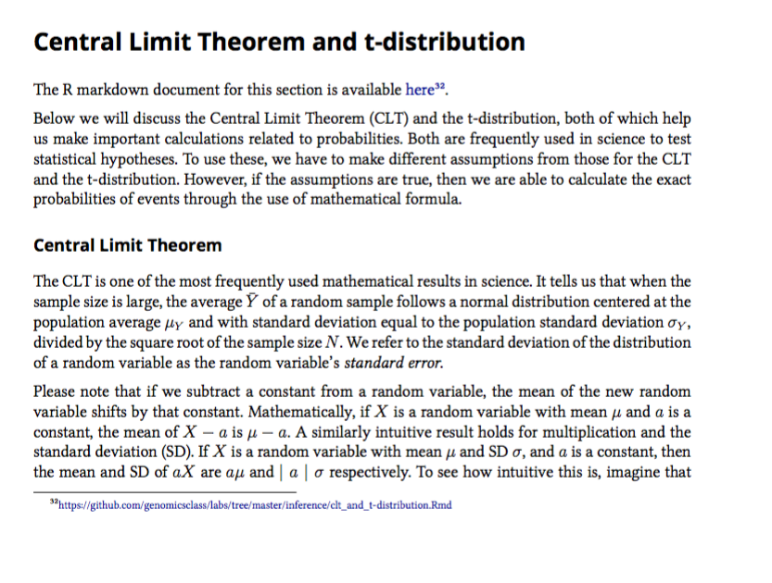
Book
Available on Leanpub (free electronic) and Amazon (hard copy)

Slide 4
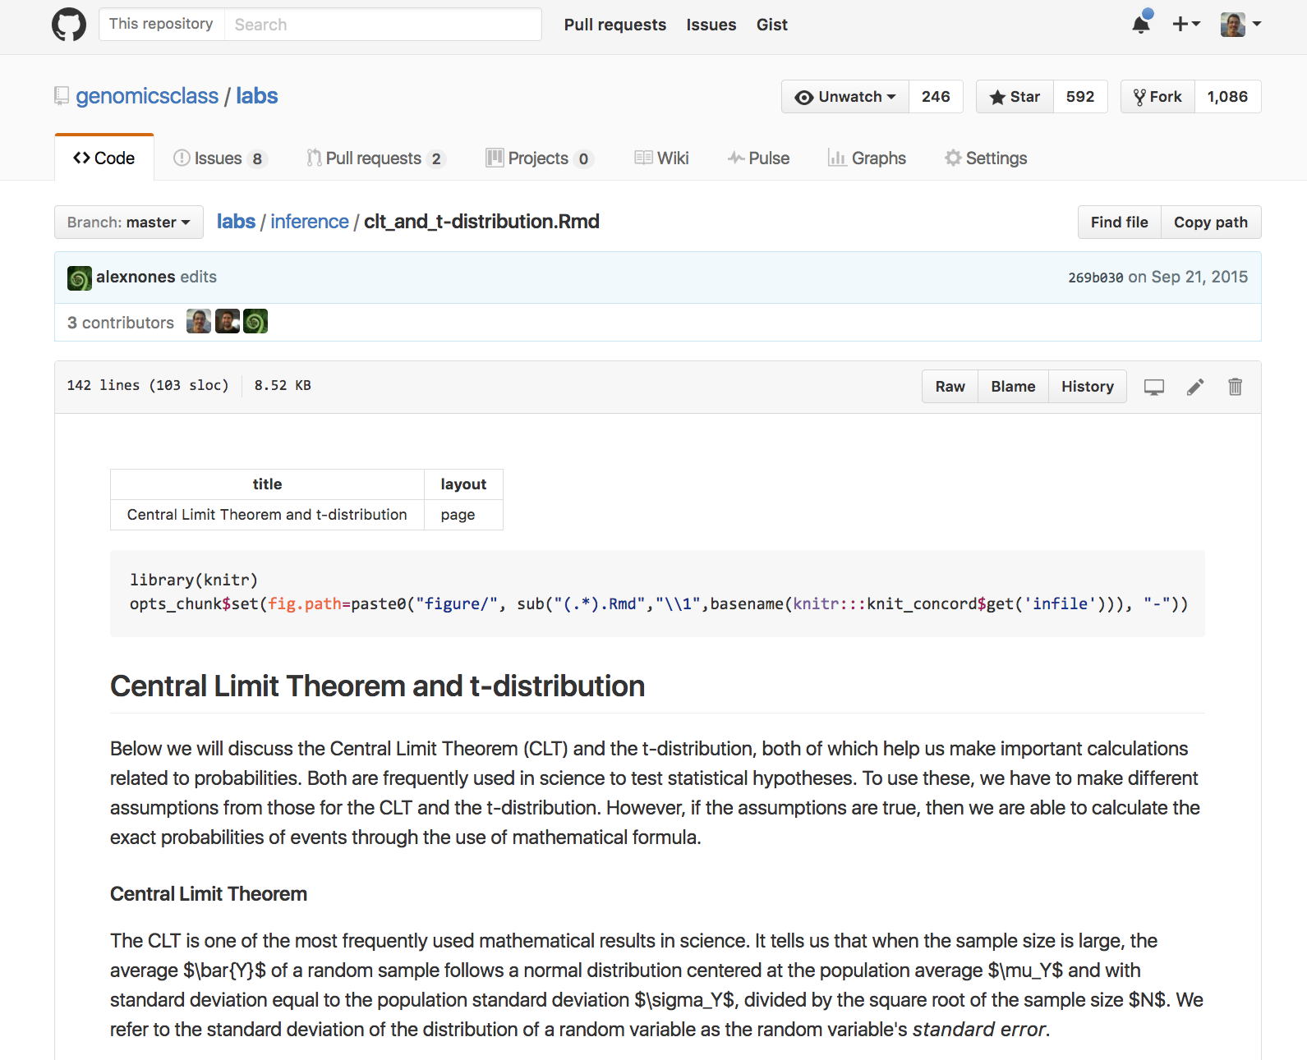
R markdown on GitHub

Slide 5
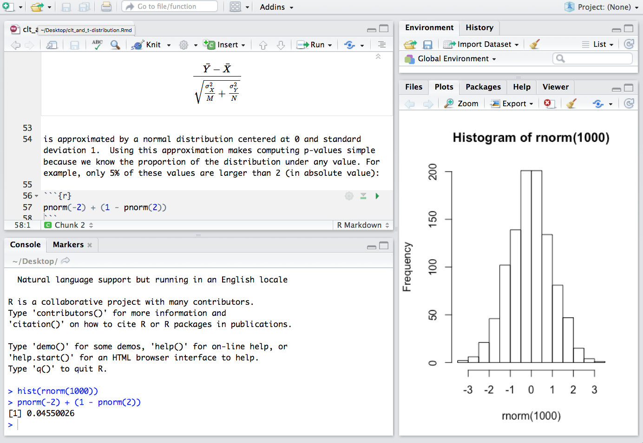
Book chapter in RStudio

Slide 6

Data Analysis for Life Sciences XSeries

Slide 7
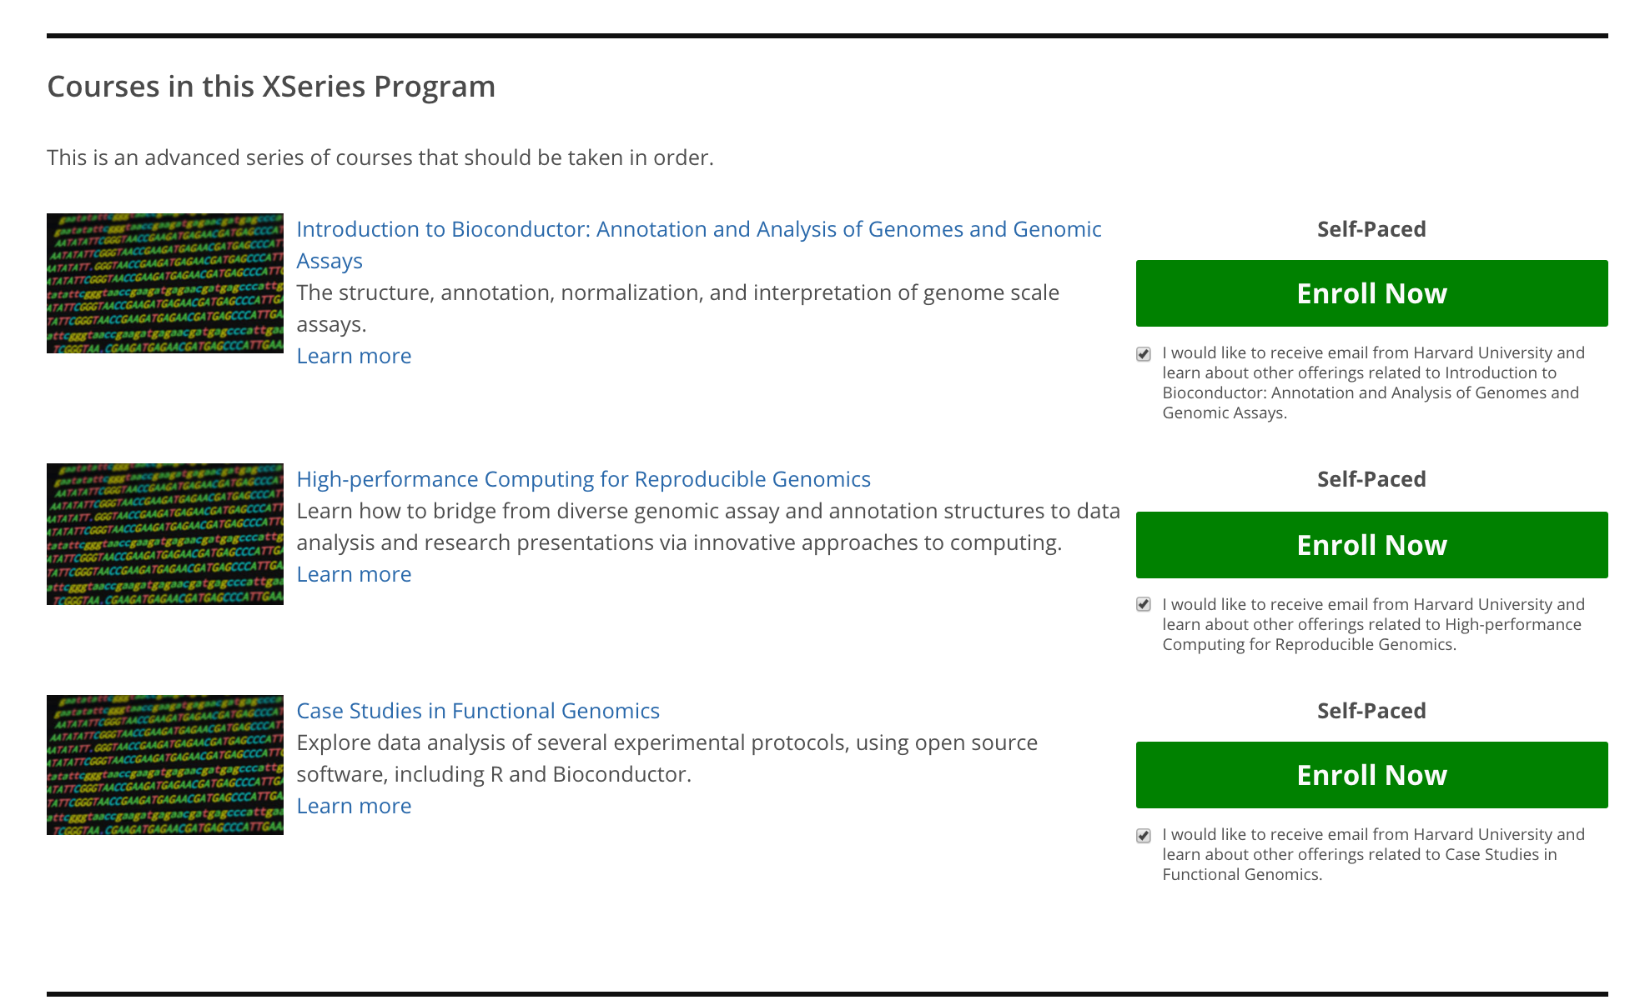
Genomics Data Analysis Xseries

Slide 8

Out of focus microscope

Slide 9
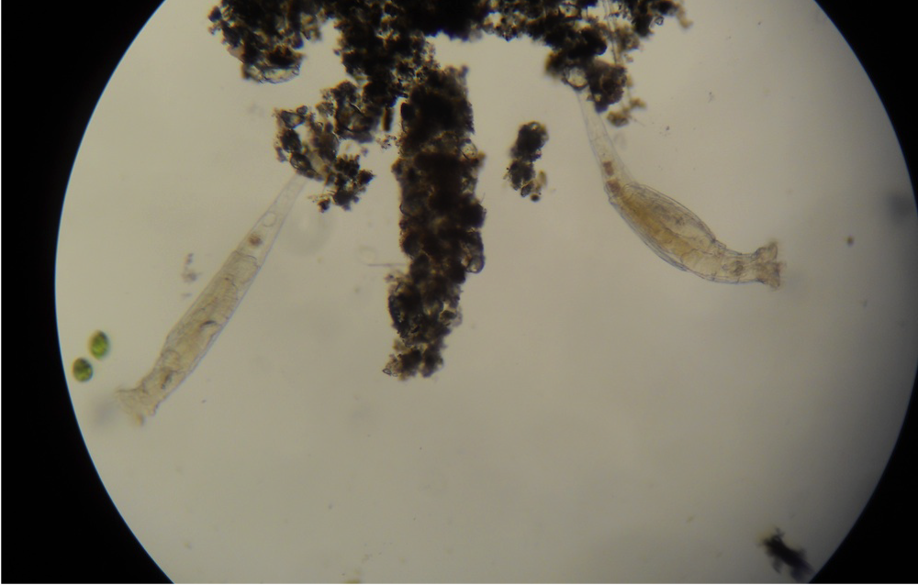
In Focus

Slide 10
Data representing five tissues

Slide 11
Out of focus gene expression data

Slide 12
Why so much noise?

Slide 13
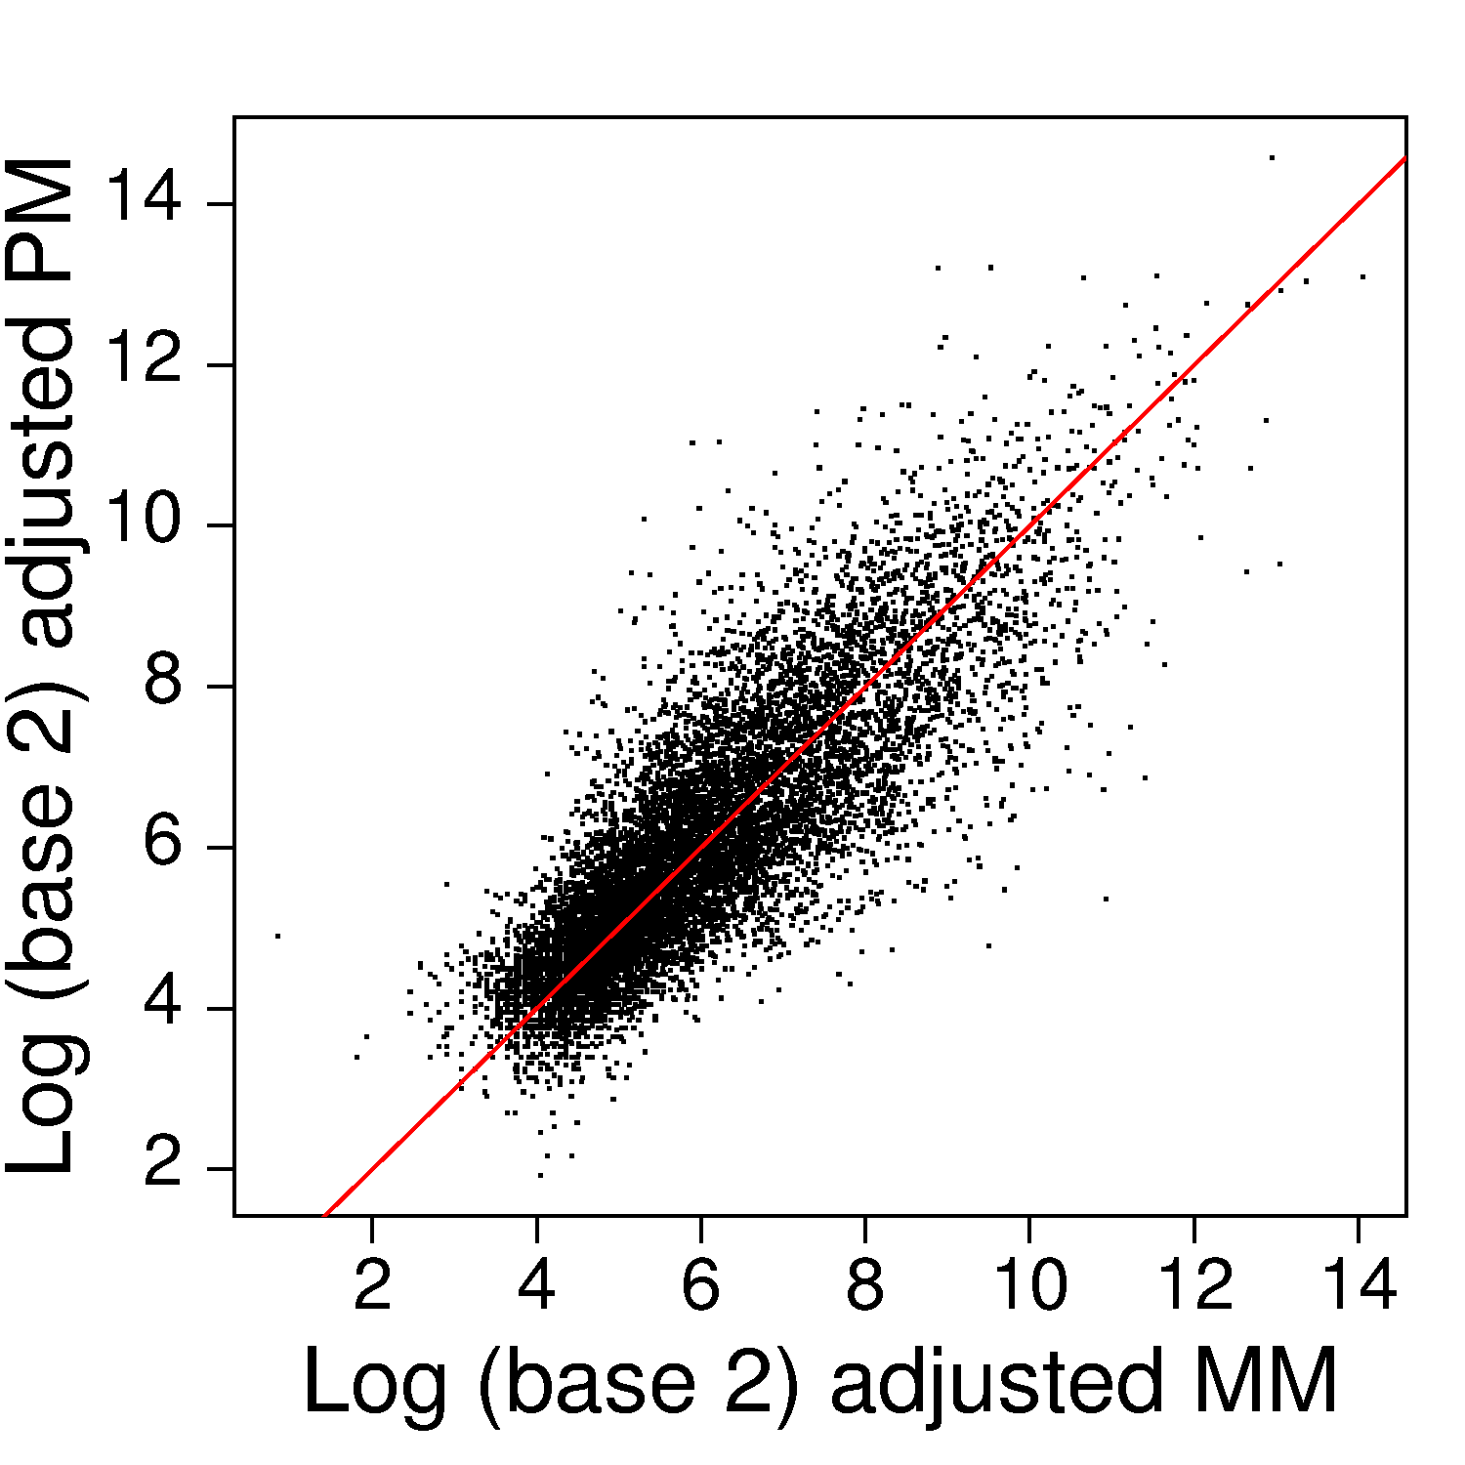
Deterministic approach
We want to estimate β, the hope is that:
Y₁ = α + β
Y₂= α
Y₁ - Y₂ = β
But this is not correct!
Notice
We care about ratios
We usually take log of Y
Notes:
Affymetrix’s tries to measure non-specific binding directly
cDNA technologies try to measure optical effects directly as well
PM-MM or Fg-Bg is supposed to estimate specific binding
It is not so simple

Slide 14
Stochastic approach
Better to assume:
Y₁ = α₁ + β
Y₂= α₂
Corr[ log(α₁), log(α₂)] = 0.7
Var[log(Y₁– Y₂*)] ~1/β ²
Alternative solution:
E[ β | Y₁, Y₂ ]
Notes:
Yeast on human Data suggest backgrounds are correlated not equal
Our first approach assumed B is normal and S exponetial the result was RMA

Slide 15
Why so much noise?

Slide 16
Our approach (RMA)
Irizarry et al. (2003) Biostatistcs

Slide 17
Out of focus

Slide 18
In focus

Slide 19
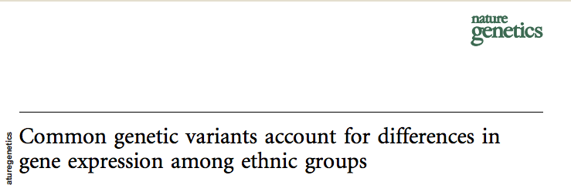
More data, more problems…
“This quantitative phenotype differs significantly between European derived and Asian-derived populations for 1,097 of 4,197 genes tested.”

Slide 20
Blood RNA from different ethnicities
MDS plot

Slide 21
Now color is date
MDS plot

Slide 22
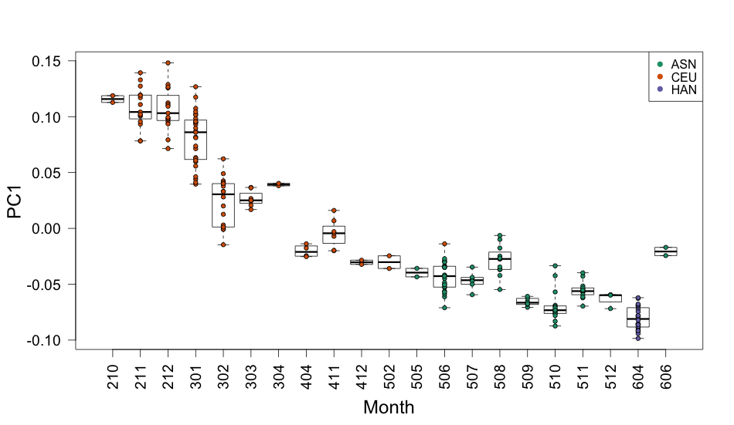
Boxplot of first PC by month

Slide 23
Blood RNA from different ethnicities

Slide 24
General problem
Notes:
%Y_{1,i} = \beta + \varepsilon_{1,j} \\
%Y_{2,i} = \alpha + \beta + \varepsilon_{ij}
%\bar{Y}_2 - \bar{Y}_1 \approx \beta
\bar{Y}_2 - \bar{Y}_1 \approx \beta \pm \sigma/\sqrt{N}

Slide 25
General problem
Notes:
%Y_{1,i} = \beta + \varepsilon_{1,j} \\
%Y_{2,i} = \alpha + \beta + \varepsilon_{ij}
%\bar{Y}_2 - \bar{Y}_1 \approx \beta
\bar{Y}_2 - \bar{Y}_1 \approx \beta \pm \sigma/\sqrt{N}

Slide 26
General problem
Notes:
%Y_{1,i} = \beta + \varepsilon_{1,j} \\
%Y_{2,i} = \alpha + \beta + \varepsilon_{ij}
%\bar{Y}_2 - \bar{Y}_1 \approx \beta
\bar{Y}_2 - \bar{Y}_1 \approx \beta \pm \sigma/\sqrt{N}

Slide 29
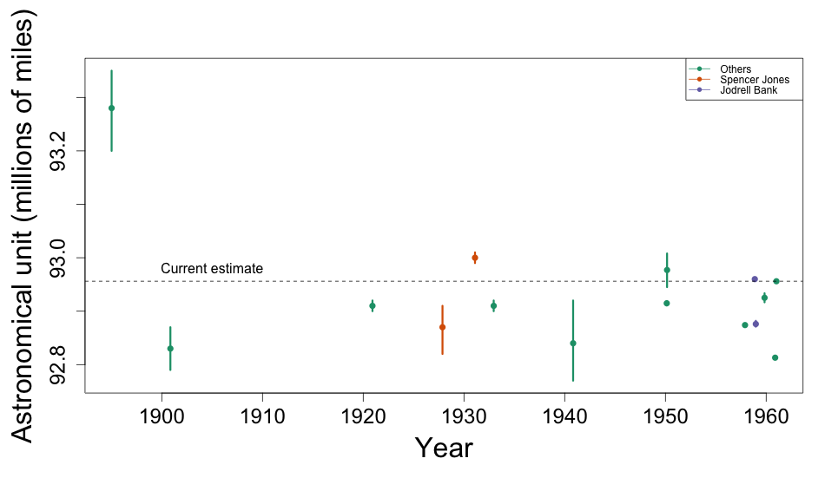
Batch Effects in Physics

Slide 30
Batch Effects in Physics
Variance of
Variance of W

Slide 31
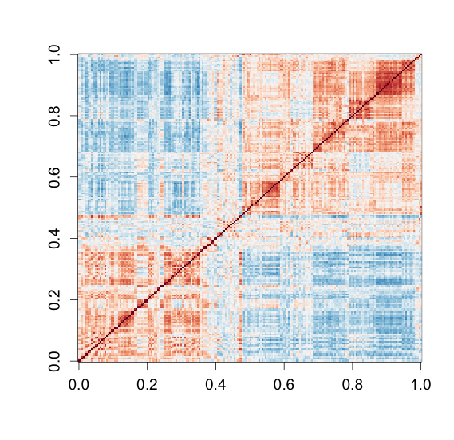
Motivates Factor Analysis Approach
Leek and Storey 2007,2008
Listgarten et al. 2010
Gagnon-Bartsch and Speed- Biostatistics, 2012

Slide 32
12 males, 12 females, two months, 109 genes
 | Female | Male
June 2005 | 3 | 9
October 2005 | 9 | 3

Slide 33
Decomposing variability
primary variables
random variation
data
observations
=
+
features
Notes:
Y_{m \times n} = \beta_{m \times p} X_{p \times n} + \varepsilon_{m \times n}

Slide 34
This model does not account for batch
primary variables
random variation
data
observations
=
+
features
Notes:
Y_{m,n} = \beta_{m,p} X_{p,n} + \varepsilon_{m,n}

Slide 35
p-value histograms
Autosome genes
Chromosome Y genes

Slide 36
Sample correlations

Slide 37
Sample correlations
Original
Order by date

Slide 38
Note structure
primary variables
random variation
data
observations
=
+
features
Notes:
Y_{m \times n} = \beta_{m \times p} X_{p\times n} + \varepsilon_{m \times n}

Slide 39
Factor analysis
primary variables
data
dependent variation
independent variation
observations
=
+
+
features
Leek and Storey 2007,2008
Notes:
Y_{m\times n} = \beta_{m\times p} X_{p\times n} + \alpha_{m\times k} W_{k\times n}
+ \varepsilon_{m\times n}

Slide 40
After Factor Analysis

Slide 41
Decomposed data
=
+
+

Slide 42
Sites that change with age ?
Rakyan VK, Down TA, Maslau S, Andrew T, Yang TP, Beyan H, Whittaker P, McCann OT, Finer S, Valdes AM, et al: Human aging-associated DNA hypermethylatio occurs preferentially at bivalent chromatin domains. Genome Res 2010, 20:434-439.
Teschendorff AE, Menon U, Gentry-Maharaj A, Ramus SJ, Weisenberger DJ, Shen H, Campan M, Noushmehr H, Bell CG, Maxwell AP, et al: Age-dependent DNA methylation of genes that are suppressed in stem cells is a hallmark of cancer. Genome Res 2010, 20:440-446.
Alisch RS, Barwick BG, Chopra P, Myrick LK, Satten GA, Conneely KN, Warren ST: Age-associated DNA methylation in pediatric populations. Genome Res 2012, 22:623-632.
Bell JT, Tsai PC, Yang TP, Pidsley R, Nisbet J, Glass D, Mangino M, Zhai G, Zhang F, Valdes A, et al: Epigenome-wide scans identify differentially methylated regions for age and age-related phenotypes in a healthy ageing population. PLoS Genet 2012, 8:e1002629.
Hannum G, Guinney J, Zhao L, Zhang L, Hughes G, Sadda S, Klotzle B, Bibikova M, Fan JB, Gao Y, et al: Genome-wide Methylation Profiles Reveal Quantitative Views of Human Aging Rates. Mol Cell 2012.
Heyn H, Li N, Ferreira HJ, Moran S, Pisano DG, Gomez A, Diez J, Sanchez-Mut JV, Setien F, Carmona FJ, et al: Distinct DNA methylomes of newborns and centenarians. Proc Natl Acad Sci U S A 2012, 109:10522-10527.
Horvath S, Zhang Y, Langfelder P, Kahn RS, Boks MP, van Eijk K, van den Berg LH, Ophoff RA: Aging effects on DNA methylation modules in human brain and blood tissue. Genome Biol 2012, 13:R97.
Lee H, Jaffe AE, Feinberg JI, Tryggvadottir R, Brown S, Montano C, Aryee MJ, Irizarry RA, Herbstman J, Witter FR, et al: DNA methylation shows genome-wide association of NFIX, RAPGEF2 and MSRB3 with gestational age at birth. Int J Epidemiol 2012, 41:188-199.
Johansson A, Enroth S, Gyllensten U: Continuous Aging of the Human DNA Methylome Throughout the Human Lifespan. PLoS One 2013, 8:e67378.

Slide 43
DNA methylation correlates with Age for this CpG
Data from GSE32148

Slide 44
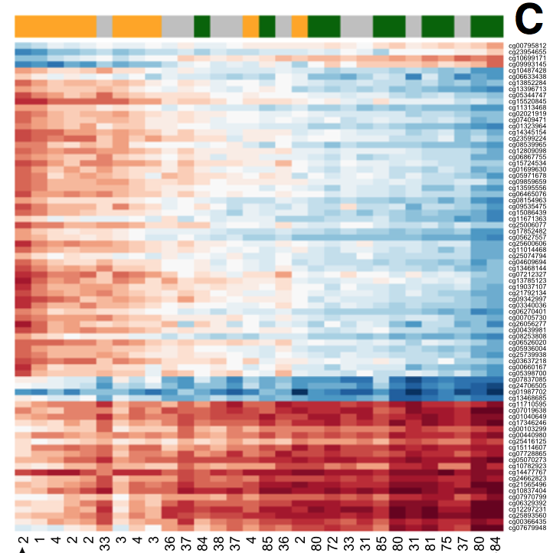
Whole Blood

Slide 45
Blood is a mixture of many cell types

Slide 46
Blood is a mixture of many cell types

Slide 47
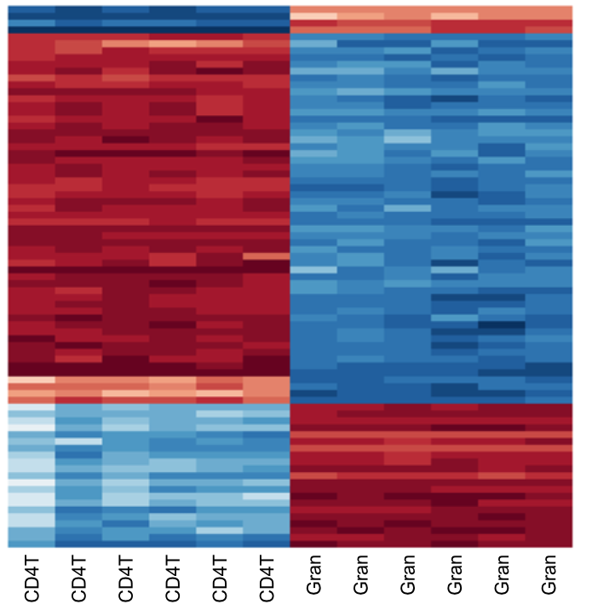
Close up

Slide 48
Sorted cell types
Whole blood

Slide 49
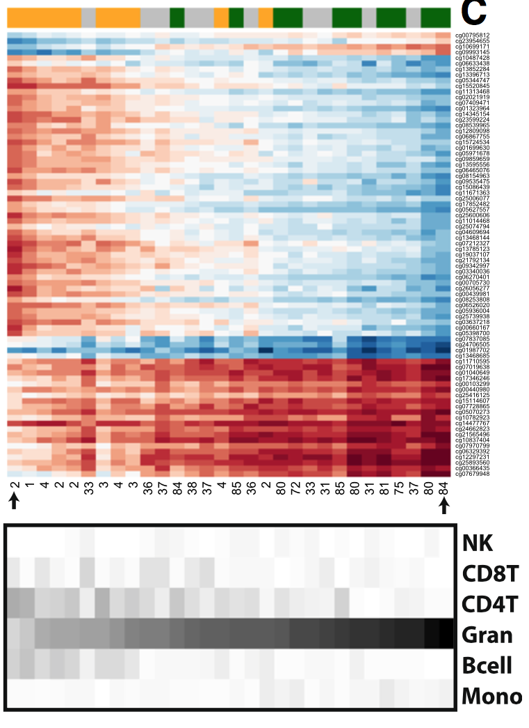
Cell composition changes with age

Slide 50
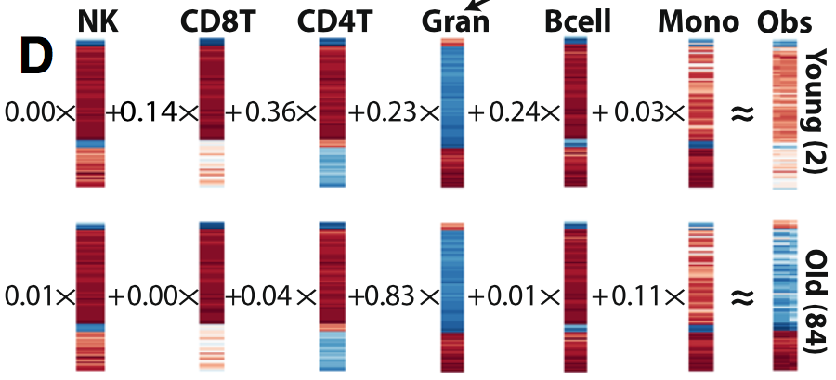
Different composition implies different profile
Jaffe and Irizarry (2014) Genome Biology

Slide 51
Cell composition versus age

Slide 52
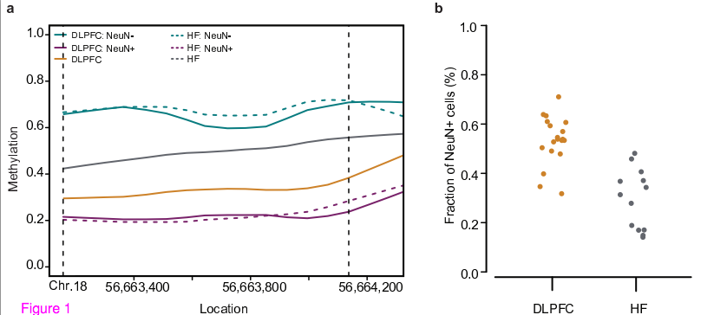
Confounding differences in brain methylation
Montaño et al (2013) Genome Biology

Slide 53
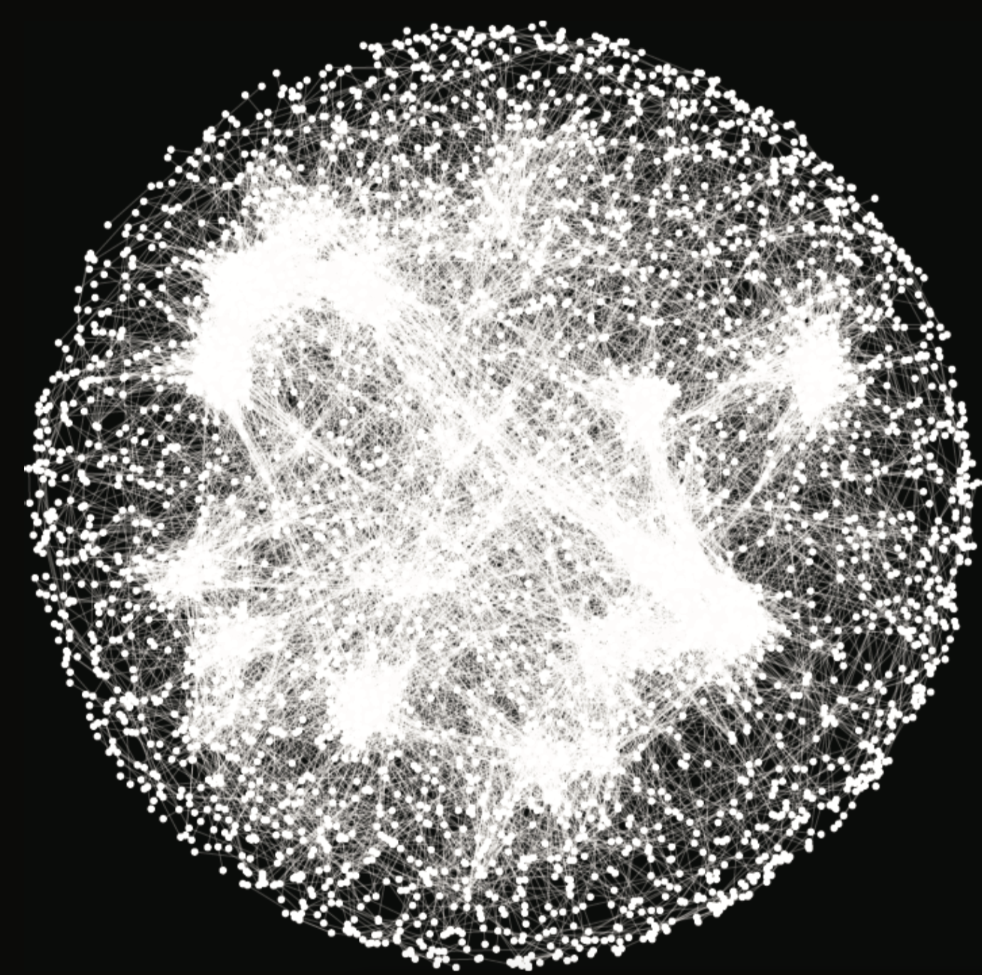
Systems Biology Plot

Slide 54
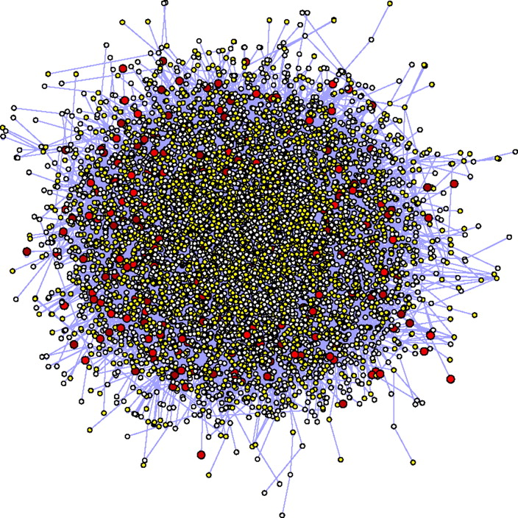
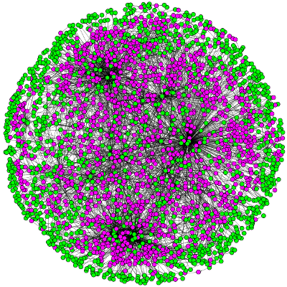
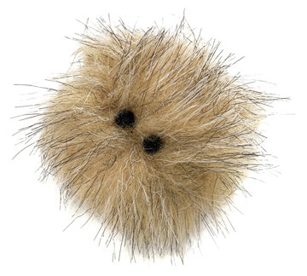
More examples

Slide 55
Let’s look at one edge
RSP24 and MRPL33 are
negatively correlated

Slide 56
Raw data confirms negative correlation

Slide 57
Batch Effects
Experiment | Correlation | p-value
GSE25076 | 0.93 | <0.01
GSE33372 | 0.71 | 0.03
GSE36674 | 0.46 | <0.01
Overall | -0.74 | <0.01
Simpons’s Paradox!

Slide 58
Raw data confirms negative correlation

Slide 59
Correlation positive once we account for batch effects

Slide 60
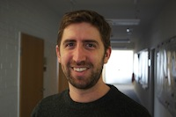
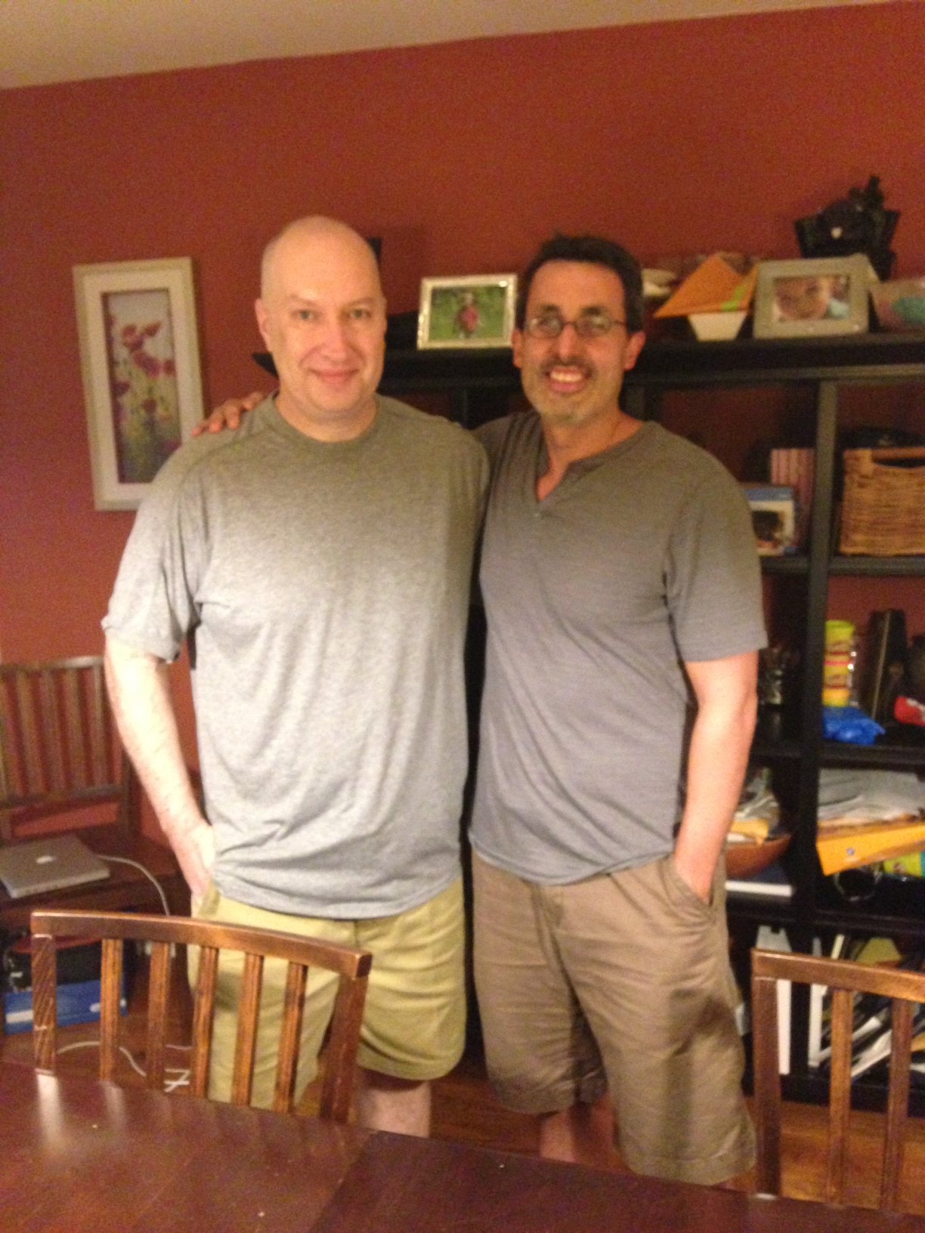
Co-authors
Mike Love
John Hogenesch

Slide 61
Data generation
θ₁=2/5
θ₂=1/5
θ₃=2/5
Reads
l₁+l₂+l₃
l₂+l₃
l₁+l₂
Transcripts
l₁
l₂
l₃
Genome

Slide 62
We see
θ₁= ?
θ₂=?
θ₃= ?
Reads
l₁+l₂+l₃
l₂+l₃
l₁+l₂
Transcripts
l₁
l₂
l₃
Genome

Slide 63
Statistical model
For example
Jiang and Wong (2009) Bioinformatics

Slide 64
Statistical model
Y’s are independent Poisson and transcript quantification is MLE of θs
Notes:
1) this not standard GLM as link is not log
2) Empirical Bayes approach are commonly used
Jiang and Wong (2009) Bioinformatics
Notes:
\mbox{E}
\begin{pmatrix}
Y_1/l_1\\
Y_2/l_2\\
Y_3/l_3\\
Y_{1,2}/l_{1,2}\\
Y_{2,3}/l_{2,3}
\end{pmatrix}
=
\begin{pmatrix}
1&1&0\\
1&1&1\\
0&1&1\\
1&1&0\\
0&1&1
\end{pmatrix}
\begin{pmatrix}
\theta_1\\
\theta_2\
\theta_3
\end{pmatrix}

Slide 65
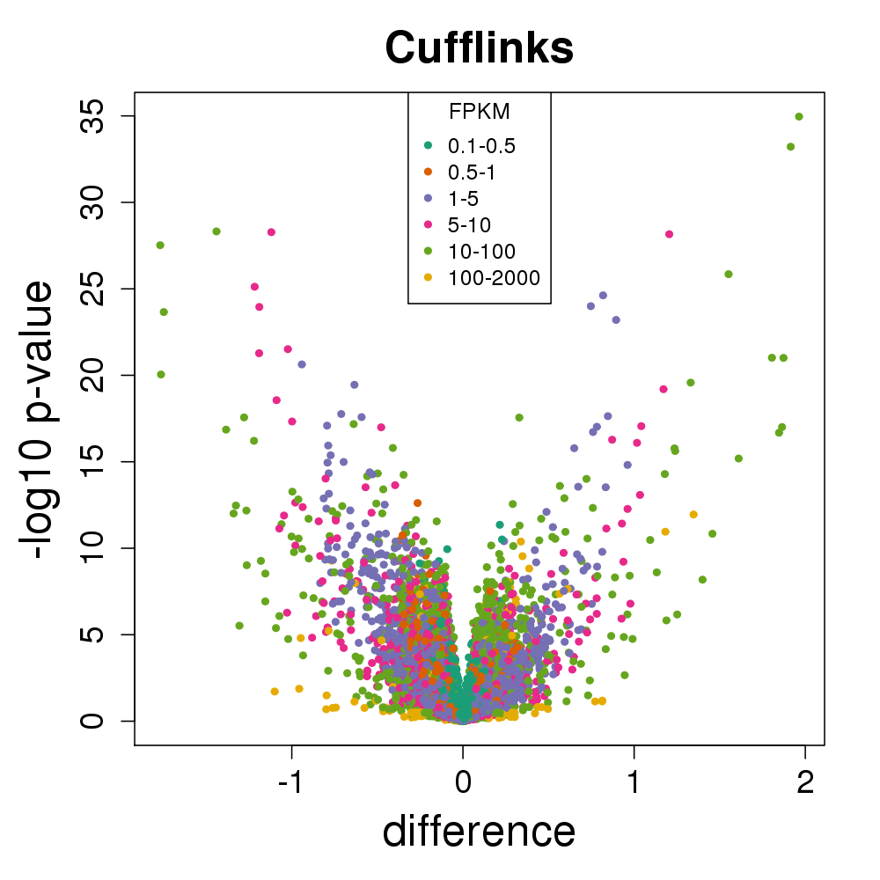
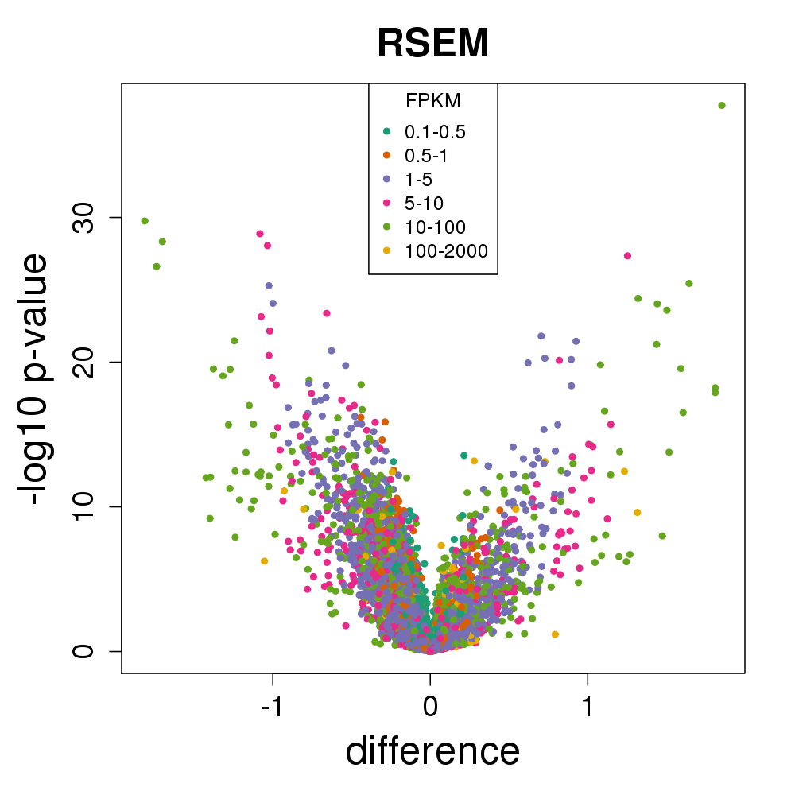
Comparison of two groups sampled from one population (from GEUVADIS)

Slide 66
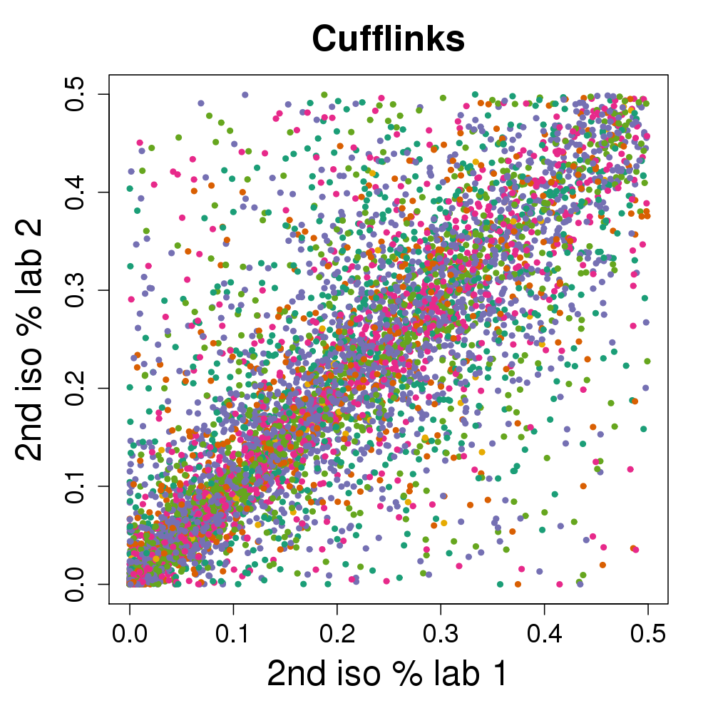
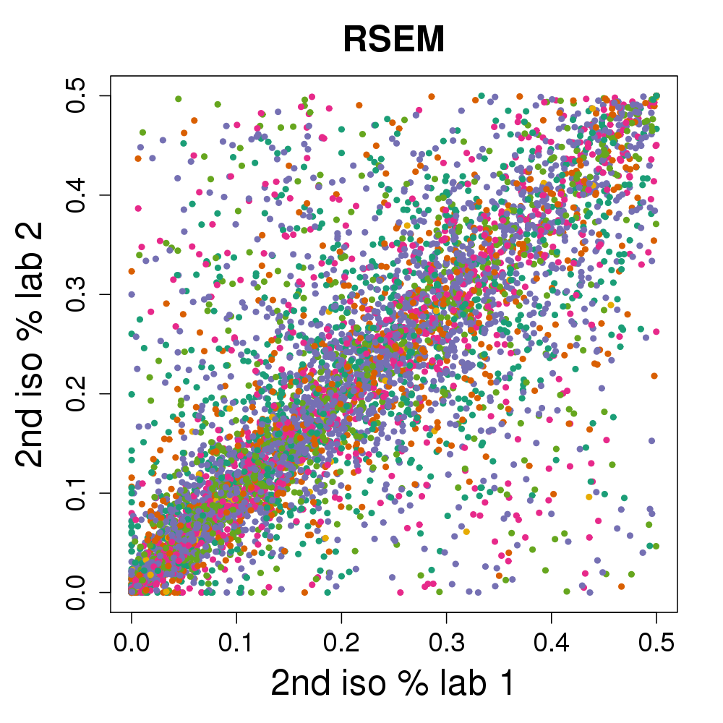
% Expression assigned to second highest isoform

Slide 67
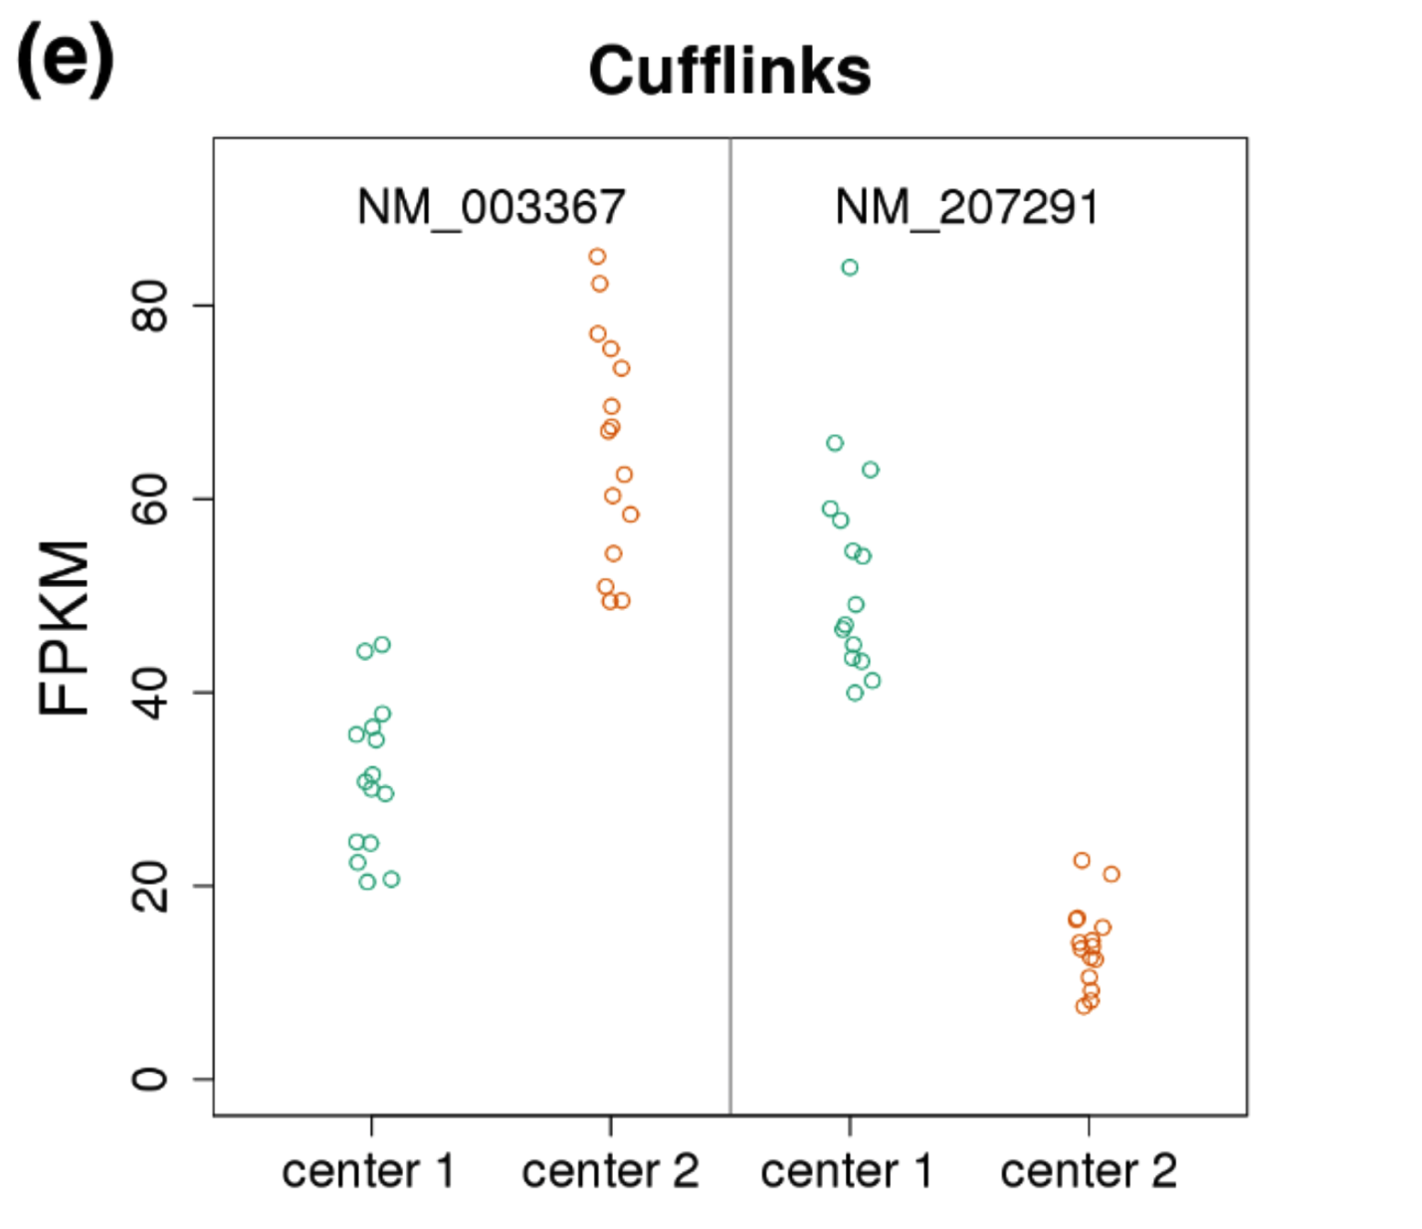
Notes:
“…we do have one hypothesis”

Slide 68
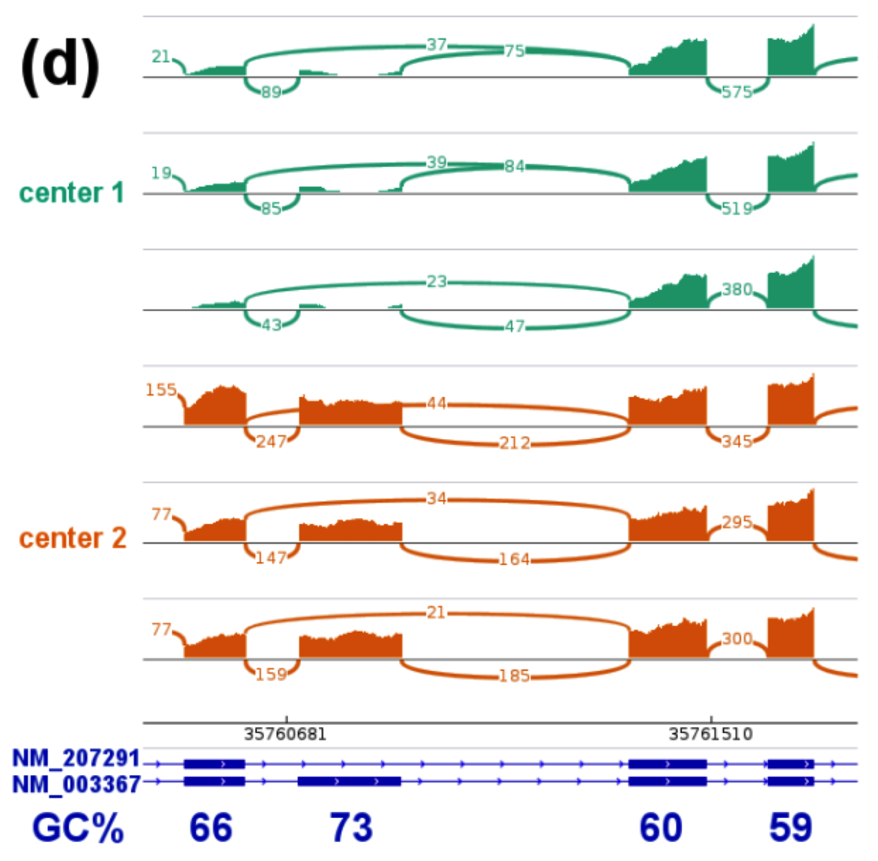
Notes:
“…we do have one hypothesis”

Slide 69
This statistical model is wrong
Y’s are independent Poisson and transcript quantification is MLE of θs
Notes:
1) this not standard GLM as link is not log
2) Empirical Bayes approach are commonly used
Jiang and Wong (2009) Bioinformatics
Notes:
\mbox{E}
\begin{pmatrix}
Y_1/l_1\\
Y_2/l_2\\
Y_3/l_3\\
Y_{1,2}/l_{1,2}\\
Y_{2,3}/l_{2,3}
\end{pmatrix}
=
\begin{pmatrix}
1&1&0\\
1&1&1\\
0&1&1\\
1&1&0\\
0&1&1
\end{pmatrix}
\begin{pmatrix}
\theta_1\\
\theta_2\
\theta_3
\end{pmatrix}

Slide 70
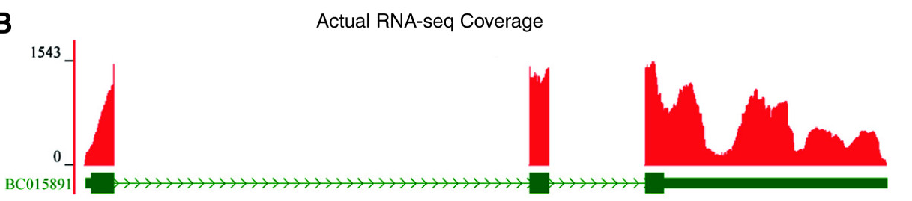
Technical artifacts in “coverage”
What should this look like?
In vitro transcription, followed by sequencing: Lahens et al (2014)

Slide 71
Statistical model with bias incorporated
Y’s are independent Poisson and transcript quantification is MLE of θs
Notes:
1) this not standard GLM as link is not log
2) Empirical Bayes approach are commonly used
Parameters no longer identifiable
Notes:
\mbox{E}
\begin{pmatrix}
Y_1/l_1\\
Y_2/l_2\\
Y_3/l_3\\
Y_{1,2}/l_{1,2}\\
Y_{2,3}/l_{2,3}
\end{pmatrix}
=
\begin{pmatrix}
1&1&0\\
1&1&1\\
0&1&1\\
1&1&0\\
0&1&1
\end{pmatrix}
\begin{pmatrix}
\theta_1\\
\theta_2\
\theta_3
\end{pmatrix}

Slide 72
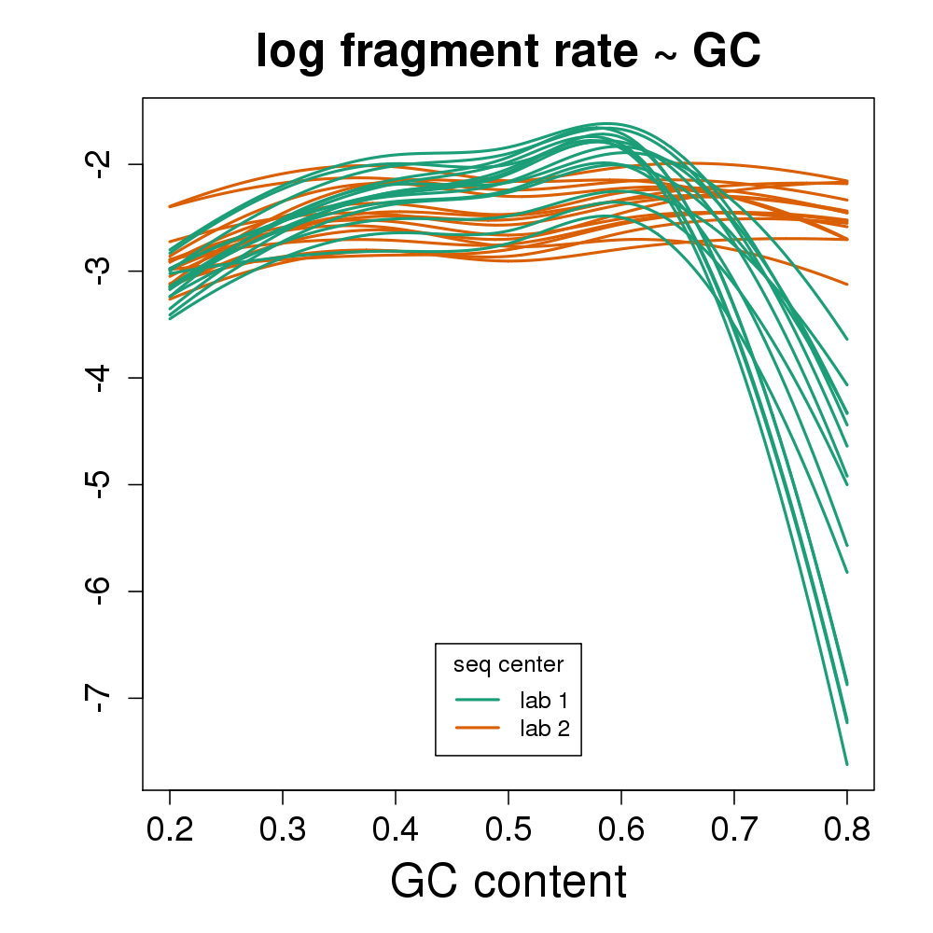
Bias varies from sample to sample
Plots from CQN: Hansen, Irizarry, Wu Biostatistics 2012

Slide 73
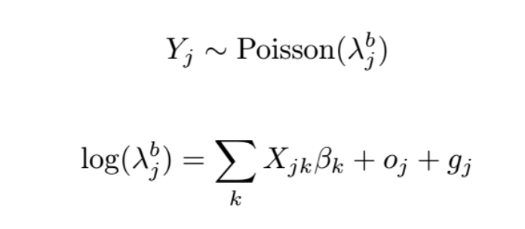
Bias varies from sample to sample
Plots from CQN: Hansen, Irizarry, Wu Biostatistics 2012

Slide 74
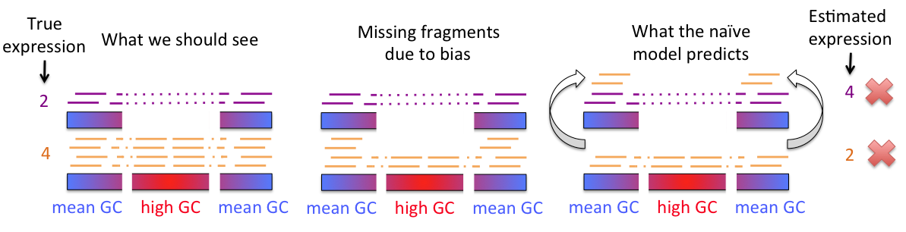

Slide 75
Notes:
“…we do have one hypothesis”

Slide 76
Alpine

Slide 77
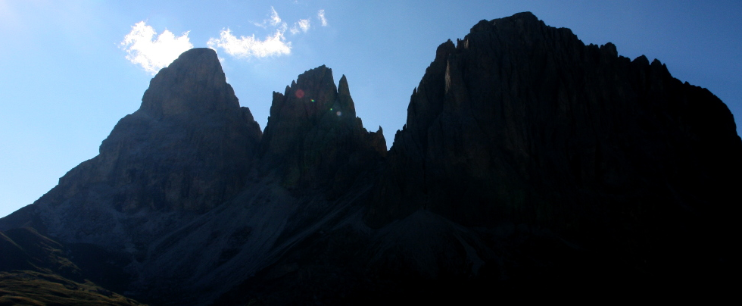
Alpine

Slide 78
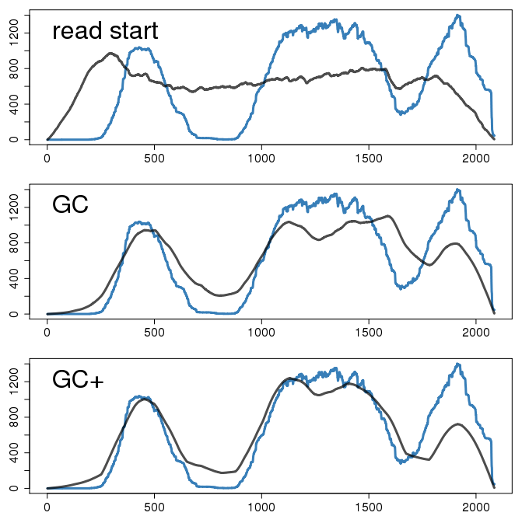
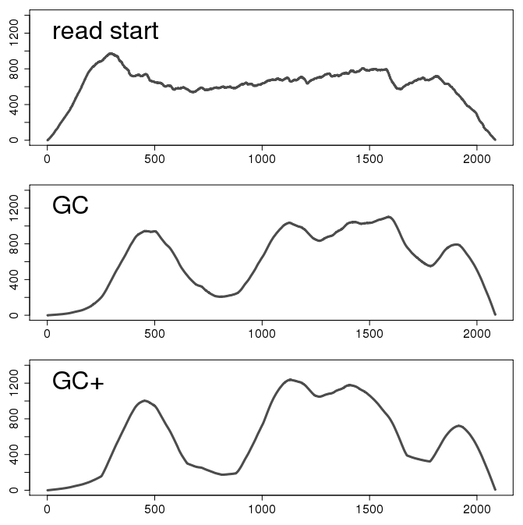
Better predict coverage artifacts
Cufflinks approach
using read starts
Transcript coverage
Test set prediction
alpine
Also modeling
stretches of (G|C)^{n}
position along transcript (bp)
Notes:
Can predict “peaks” and “valleys”
“Not getting into details, but through looking at many examples, we also discovered effects beyond fragment GC”

Slide 79
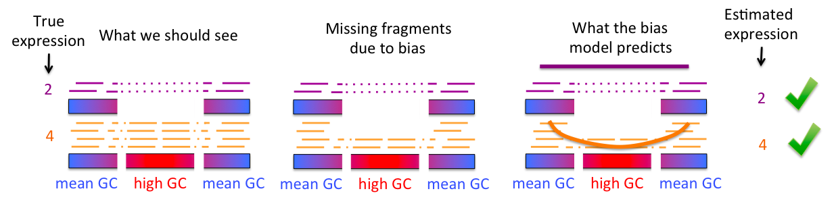
Parsimonious model

Slide 80
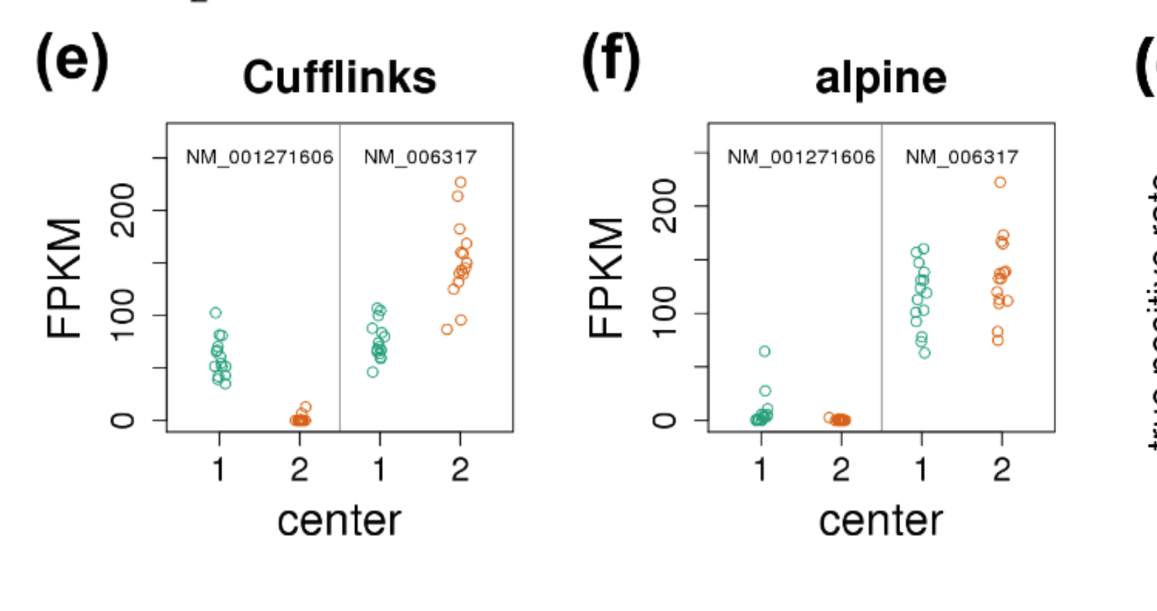

Slide 82
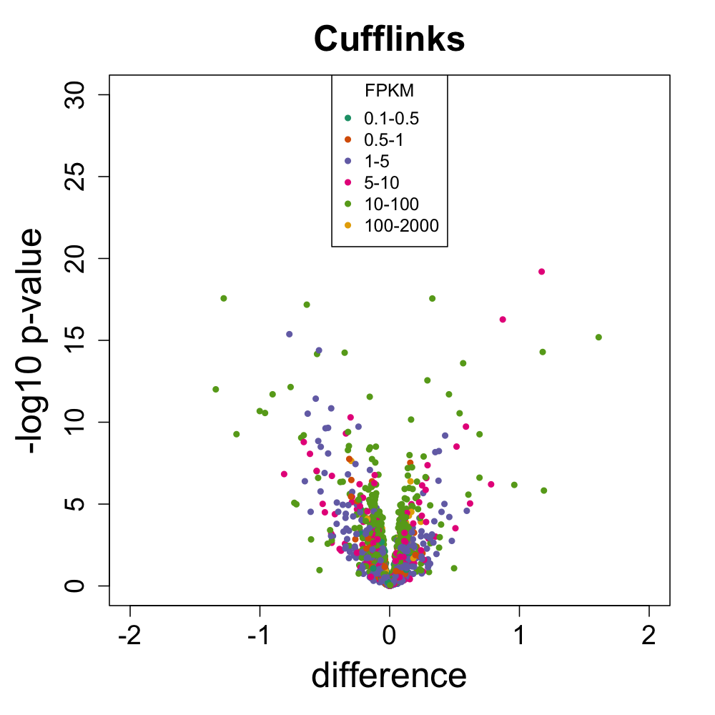
Current improvement

Slide 83
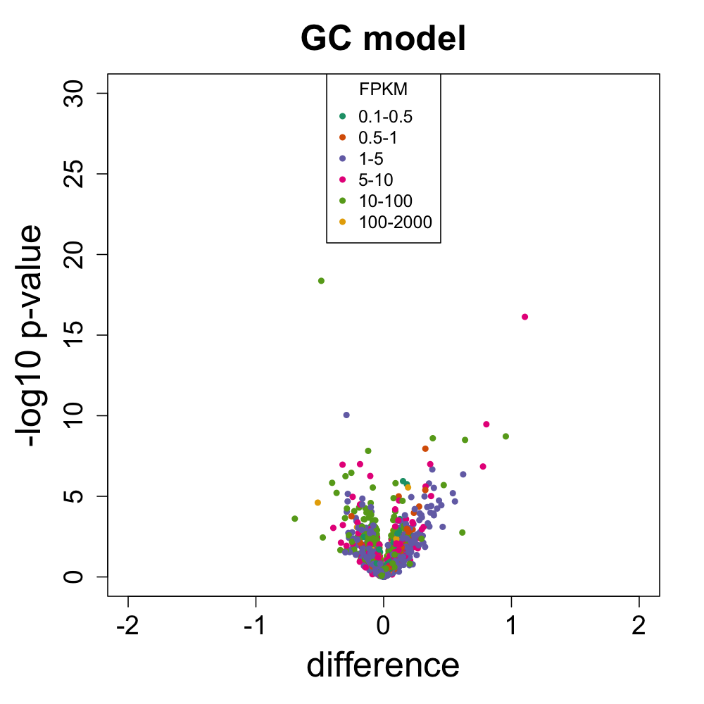

Slide 84
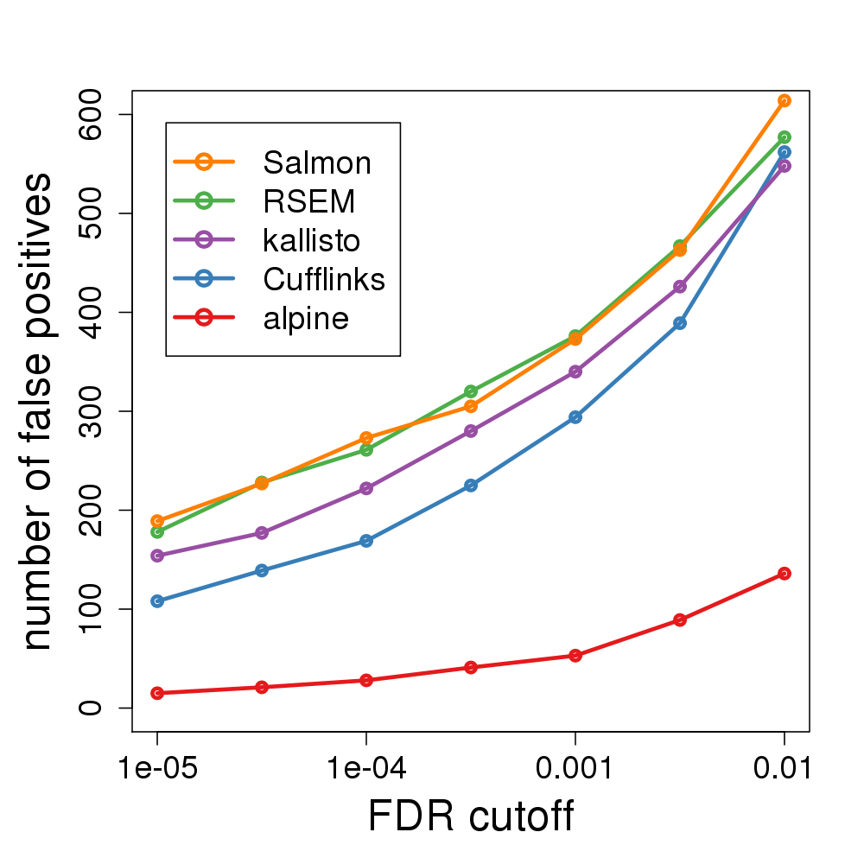
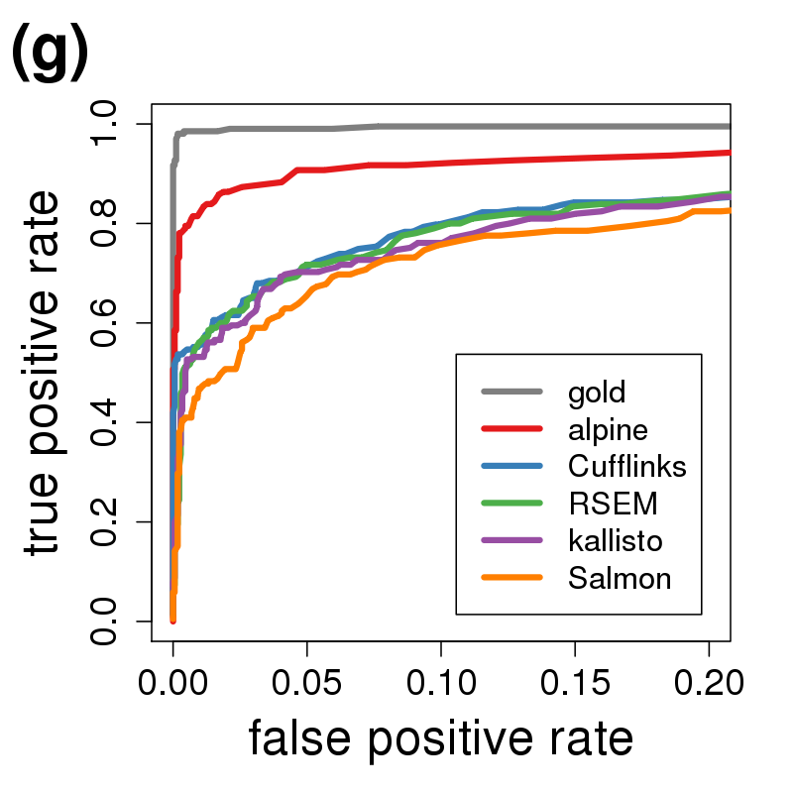
More comparisons
MC simulations used for ROC

Slide 85
Acknowledgments
Michael Love
Stephanie Hicks
John Hogenesch
Andrew Jaffe
Jeff Leek
NIH R01 grants
HG005220
GM083084
RR021967/GM103552
NIH P41 grant
HG004059
http://rafalab.org @rafalab

